Slide 1
Perceptron

Slide 2
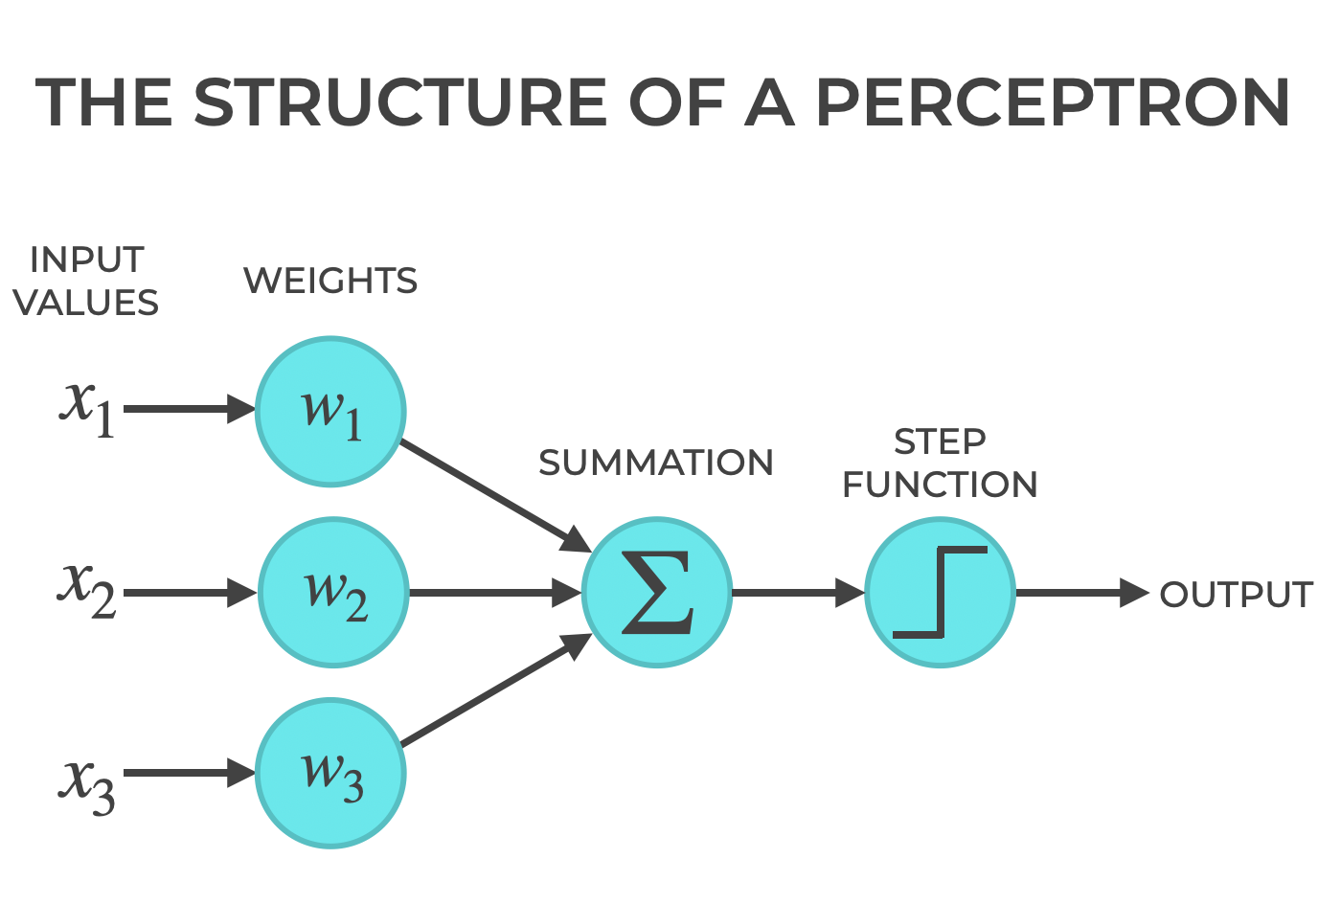

Slide 3
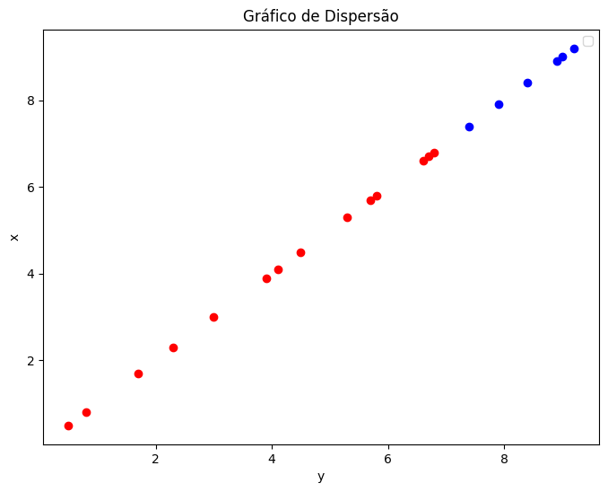

Slide 4
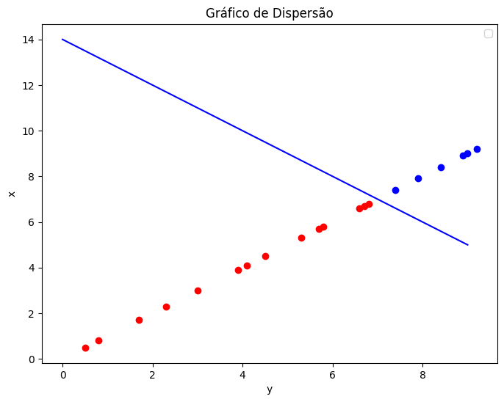

Slide 5
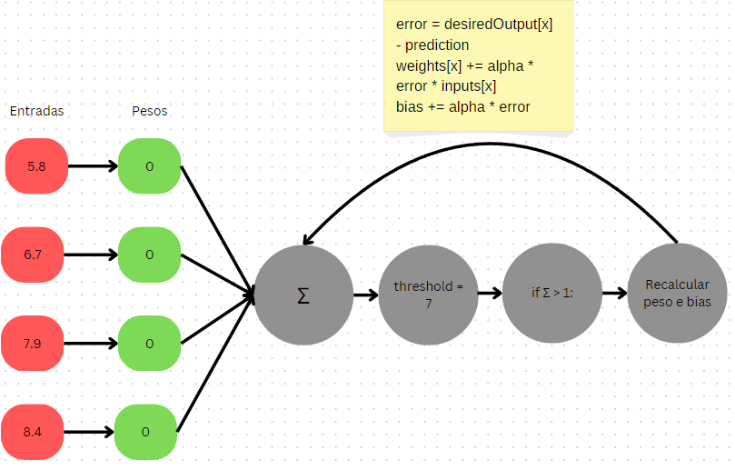

Slide 6
Definições
inputs = np.array([
5.8, 6.7, 7.9, 8.4, 9.0, 0.5, 1.7, 3.0, 4.1, 5.3,
6.6, 7.4, 8.9, 9.2, 0.8, 2.3, 3.9, 4.5, 5.7, 6.8])
threshold = 7
iteration_number = 1000
weights = np.zeros(num_samples)
bias = 0
alpha = 0.01

Slide 7
Definições
def activation_function(x, threshold):
if x >= threshold:
return 1
else:
return 0
def weightSum(inputs, weights, bias):
return inputs* weights + bias

Slide 8
Definições
def interactions(iteration_number, inputs, threshold, desiredOutput):
num_samples = inputs.shape[0]
weights = np.zeros(num_samples)
bias = 0
alpha = 0.01
for n in range(iteration_number):
for x in range(num_samples):
returnSum = weightSum(inputs[x], weights[x], bias)
prediction = activation_function(returnSum, threshold)
error = desiredOutput[x] - prediction
# Update weights and bias
weights[x] += alpha * error * inputs[x]
bias += alpha * error
return weights, bias

Slide 9
Definições
Retorno do Perceptron:
[0. 0. 0.869 0.84 0.81 0. 0. 0. 0. 0. 0. 0.888
0.801 0.736 0. 0. 0. 0. 0. 0. ]
Resultado esperado:
[0. 0. 1. 1. 1. 0. 0. 0. 0. 0. 0. 1. 1. 1. 0. 0. 0. 0. 0. 0.]

